Slide 1
Web-editor for reproducible pipelines
Data design

Slide 2
Product description
A web application and a visual studio code extension for editing pipelines with auto-saving and automatic syntax and cohesion checking, embedded into the “MLOps Platform”.
MLDev experiments configurations CRUD.
Online editor with syntax highlighting, formatting.
Real Time collaboration with built-in git support system.
Experiments visualizer.
Team: Daniil Fedorov (Architect, system analyst), Sergeev Ilya (Architect, full-stack developer), Shtanov Andrey (Architect, UI-developer)
Repo: https://github.com/dr0p-table-users/asd
Report: https://docs.google.com/presentation/d/16DIU3XuwnD1nDst31tdB4Pb0BHU_DQir1NVBh-NM-tc/edit?usp=sharing

Slide 3
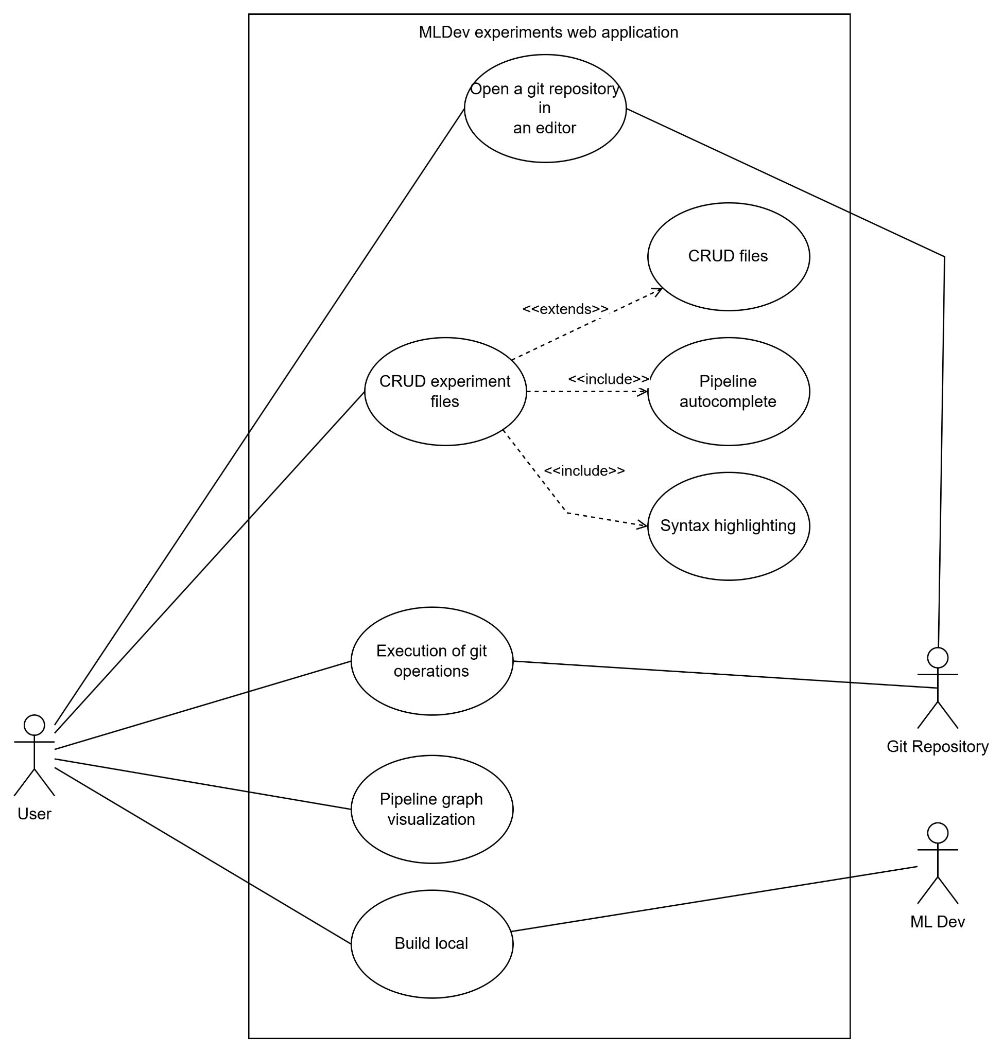
Use case diagram or event flow
(take from the previous task)
Show main scenarios or the event flow on a diagram
Provide a link to structured textual use case scenarios in your project repo.

Slide 4
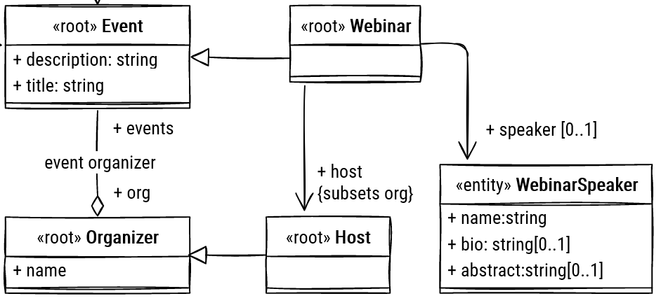
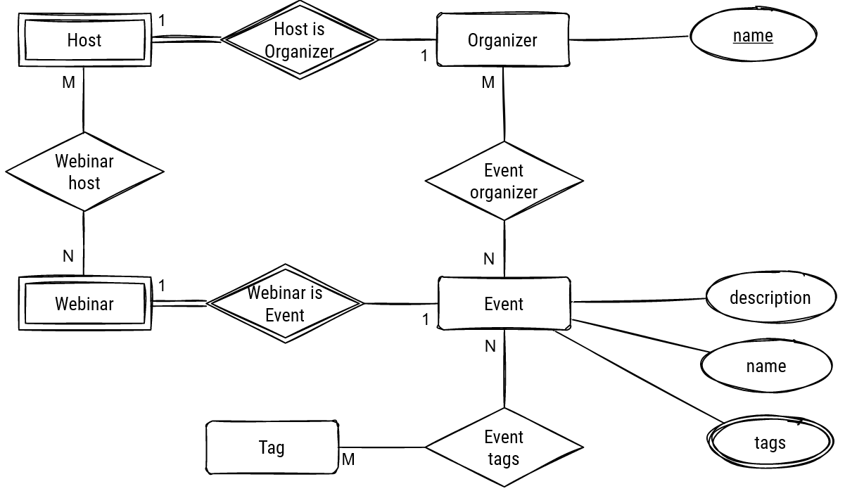
Logical data model (class/ER diagram)
(from the previous task)
<for each microservice separately>

Slide 5
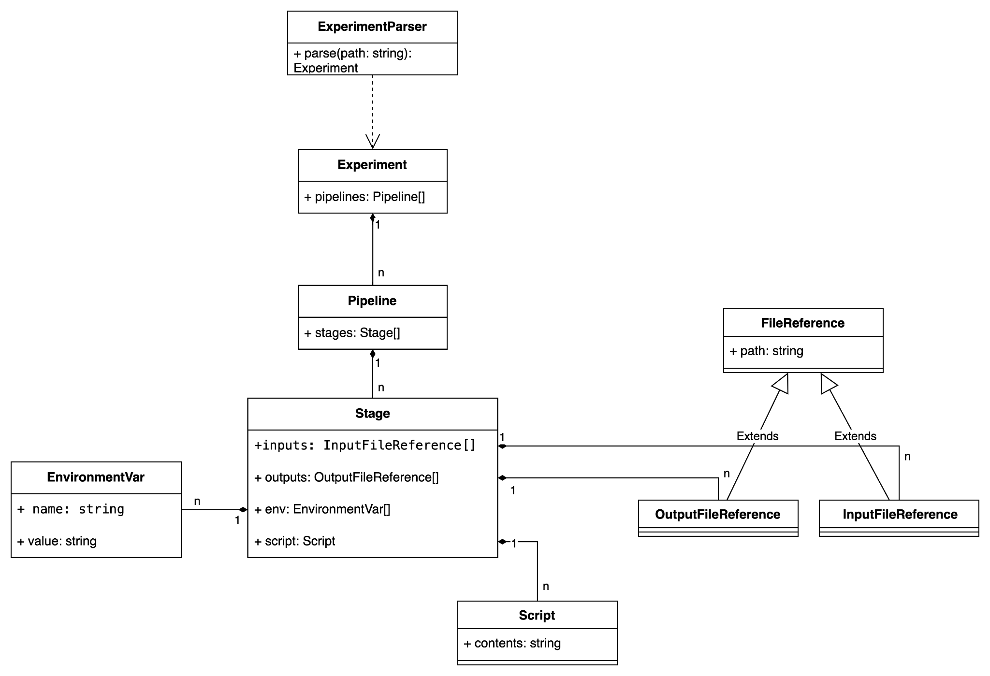
Class Diagram (Experiment Structure Parser)

Slide 6
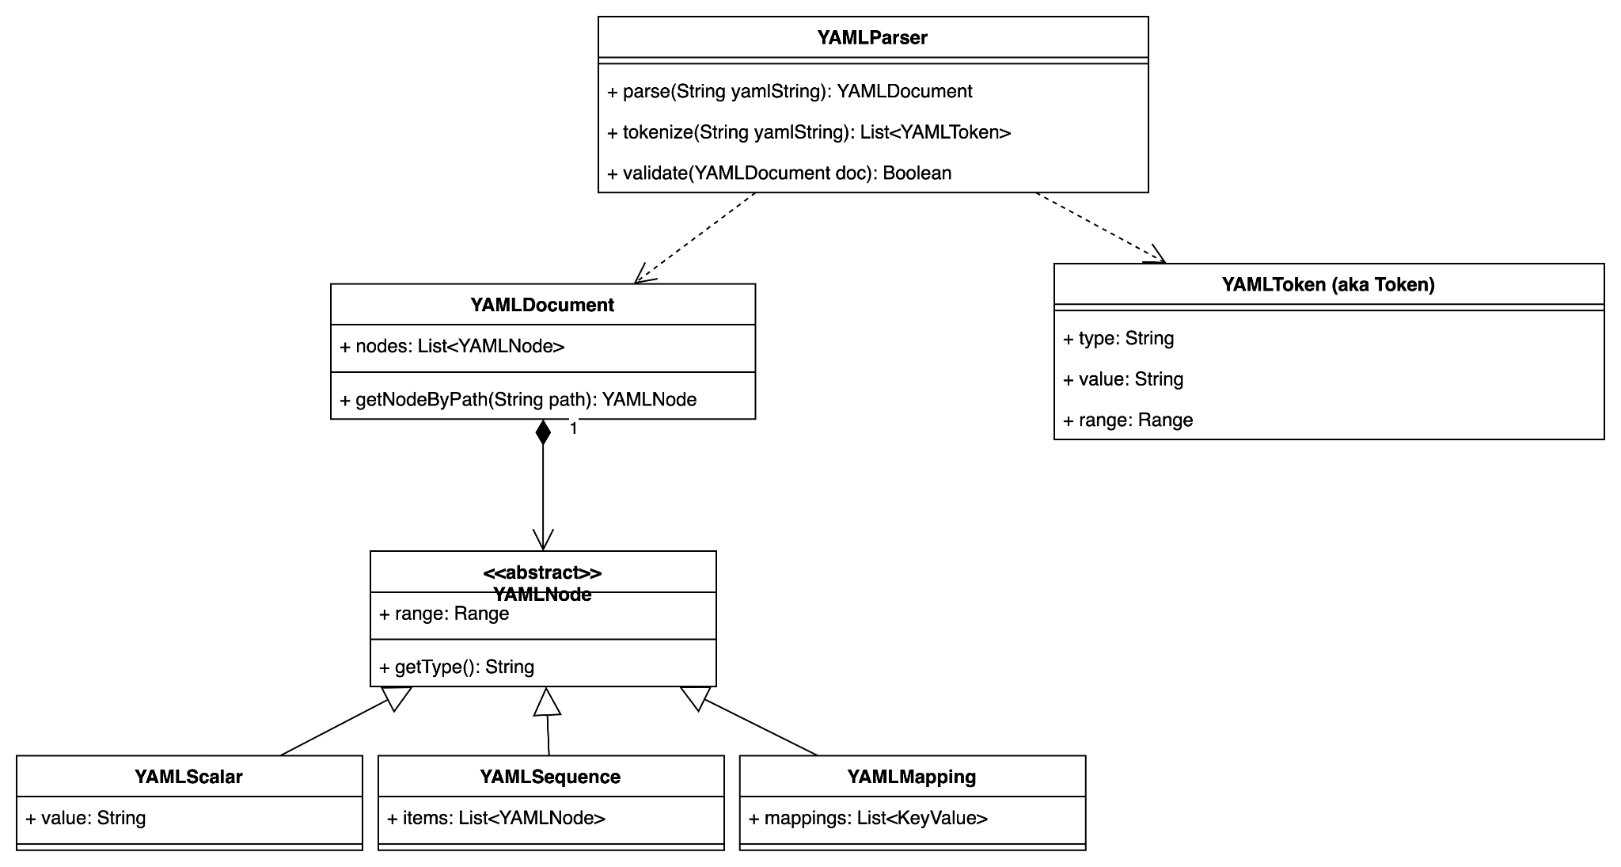
Class Diagram (Syntax Analyzer)

Slide 7
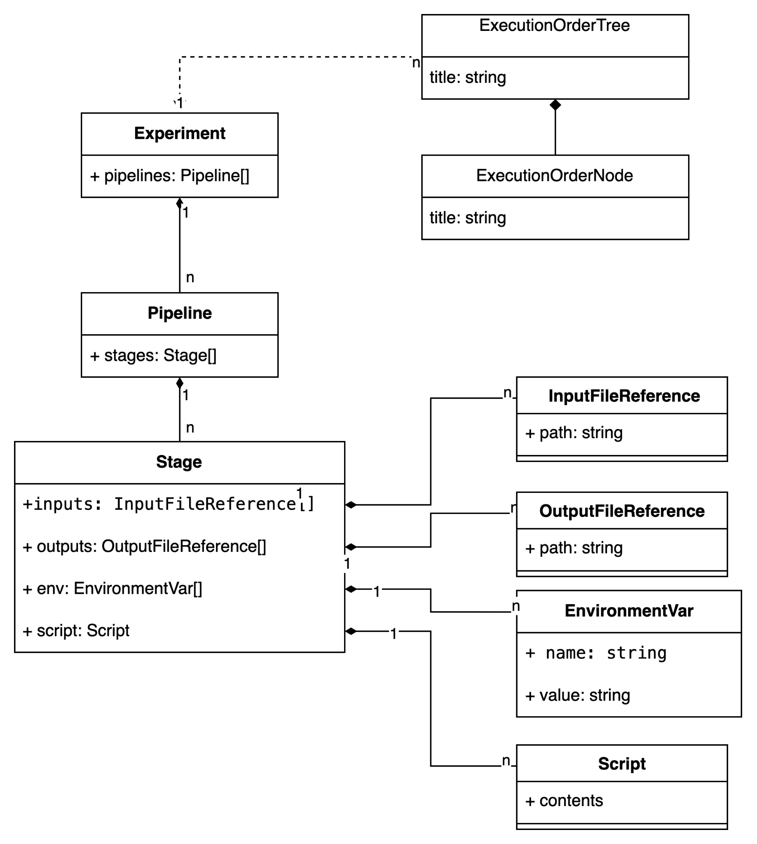
Logical data model (Visualizer)

Slide 8
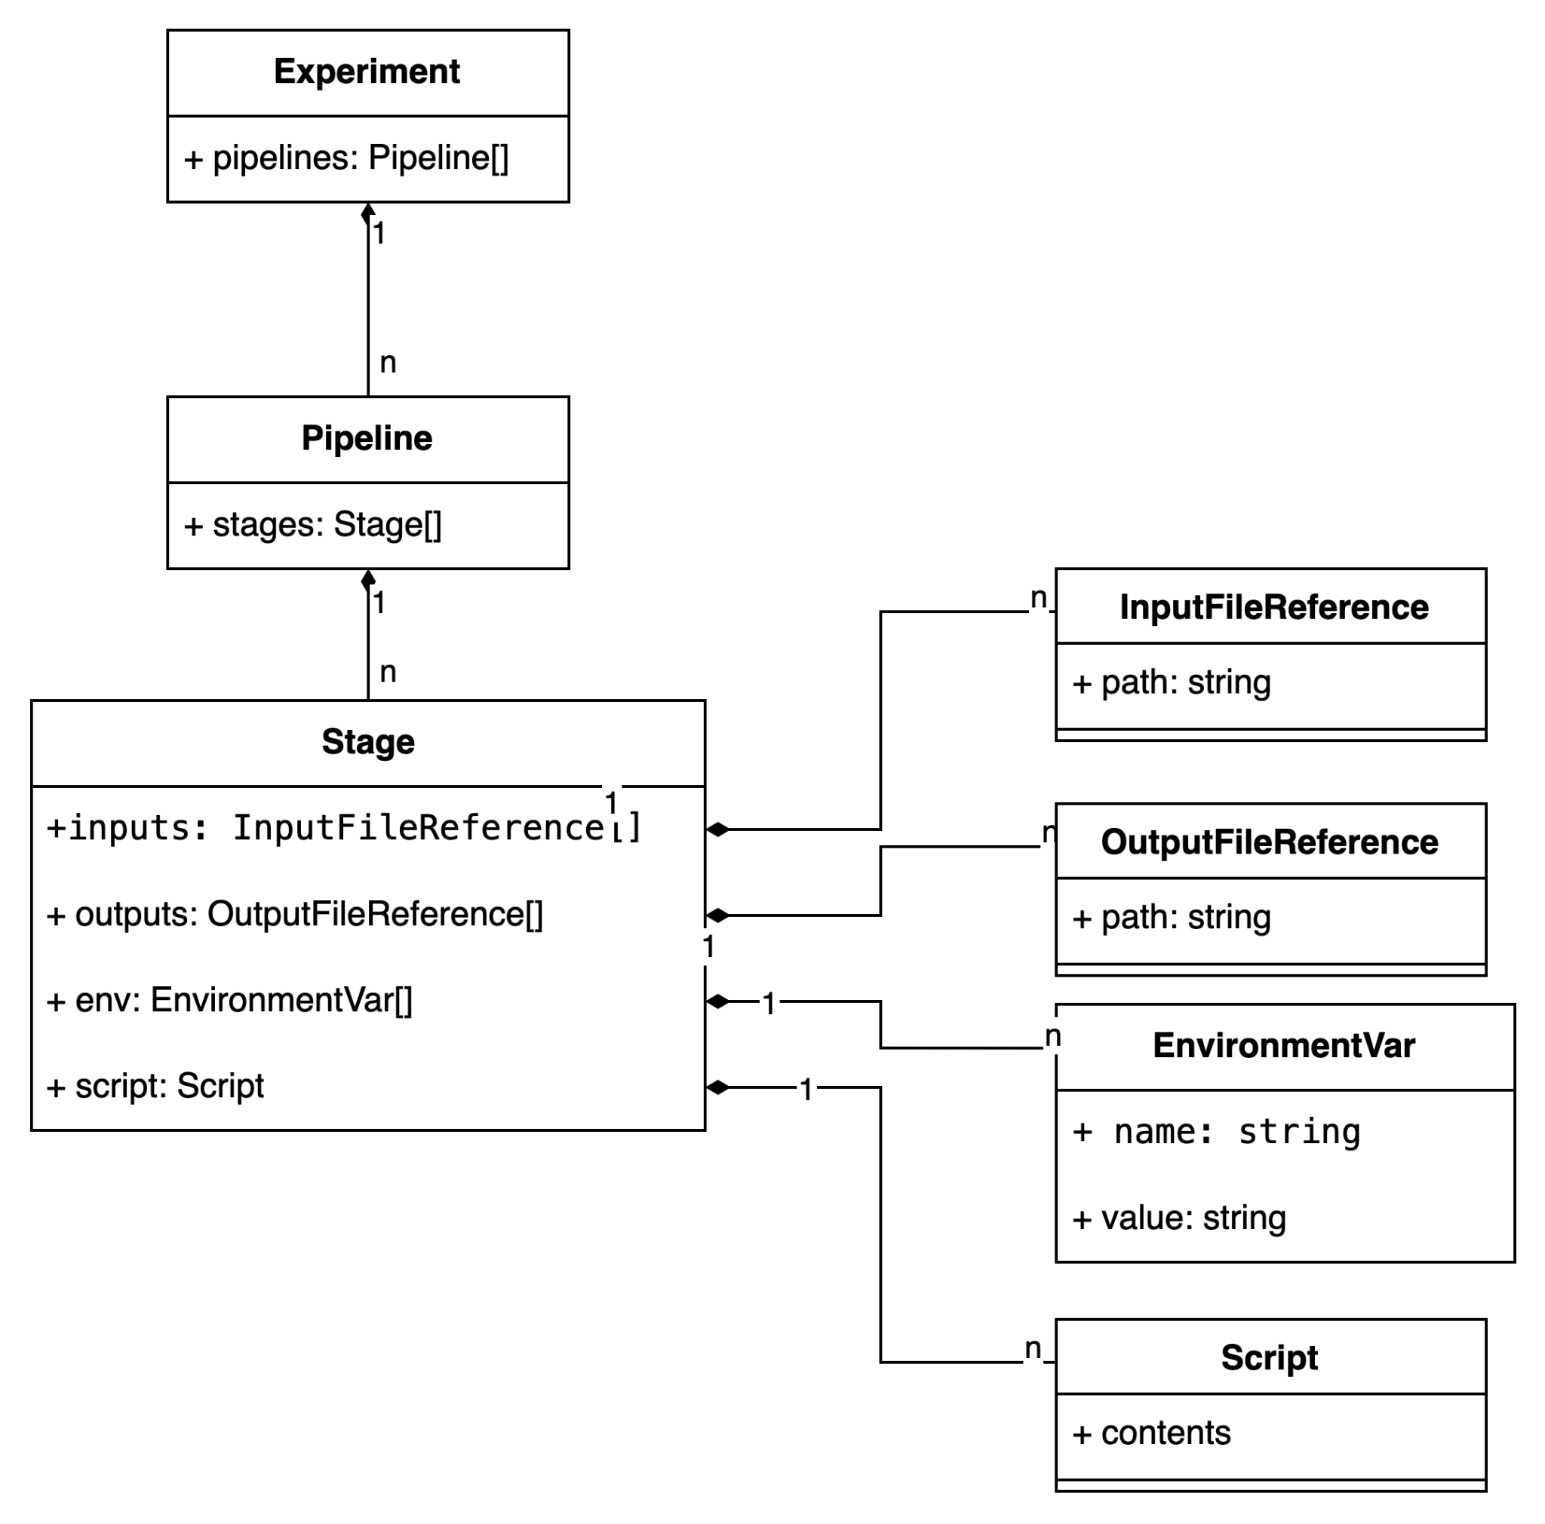
Logical data model (Experiment Structure Parser)

Slide 9
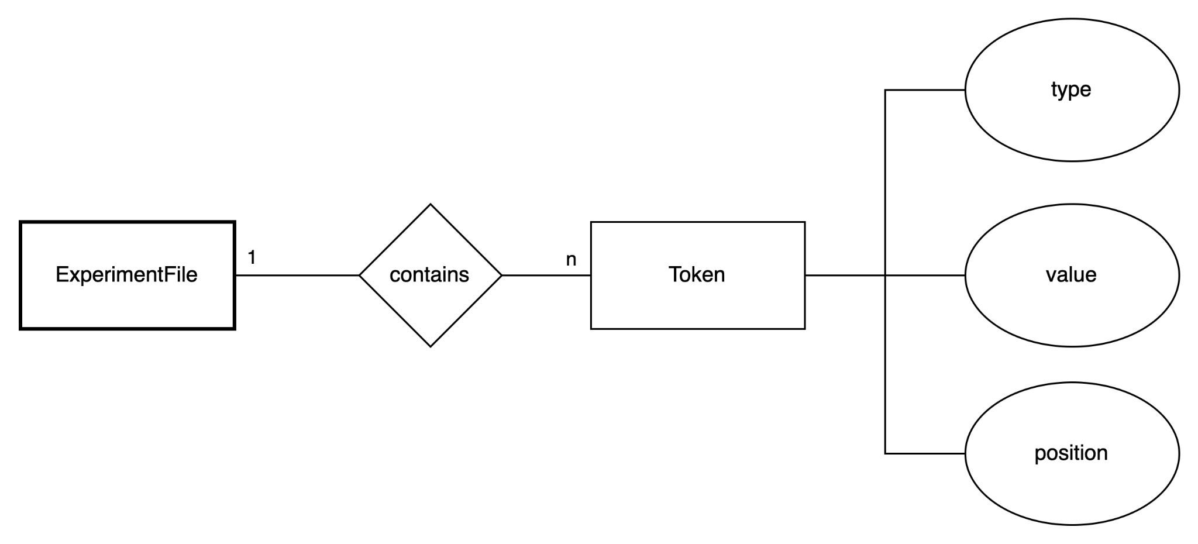
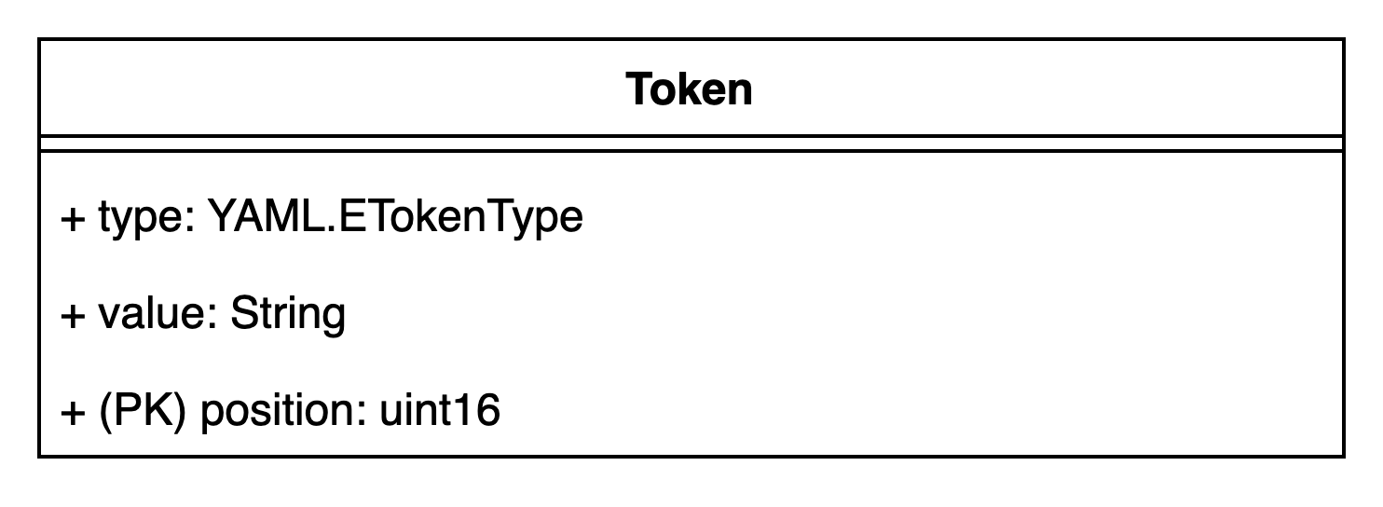
Logical data model (Syntax Analyzer)
Class diagram
ER diagram

Slide 10
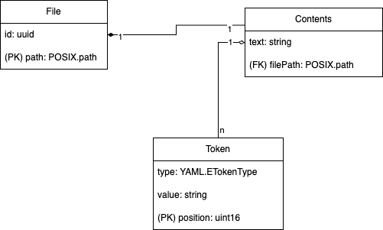
Logical data model (Project file system & Web-Editor)

Slide 11
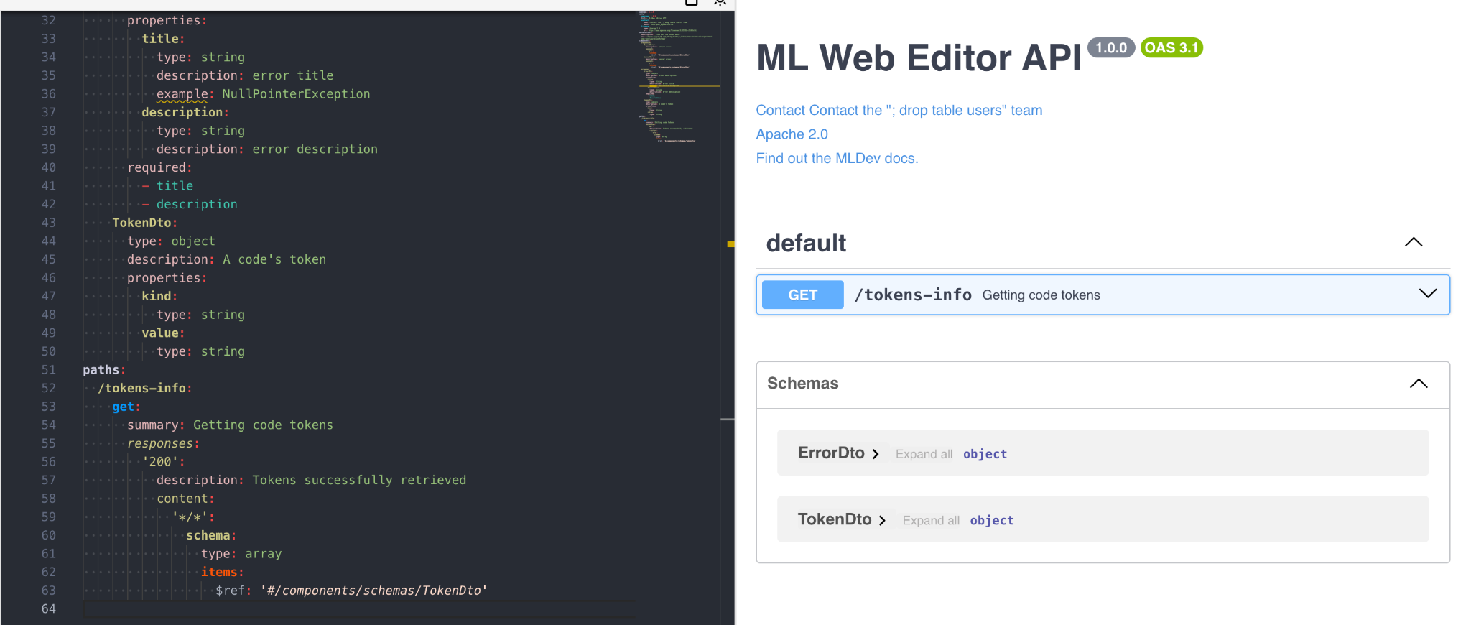
Open API. Web Editor

Slide 12
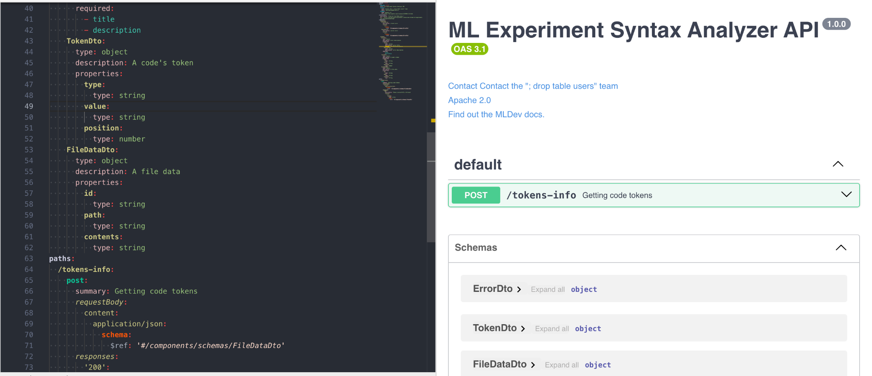
Open API. Syntax Analyzer

Slide 13
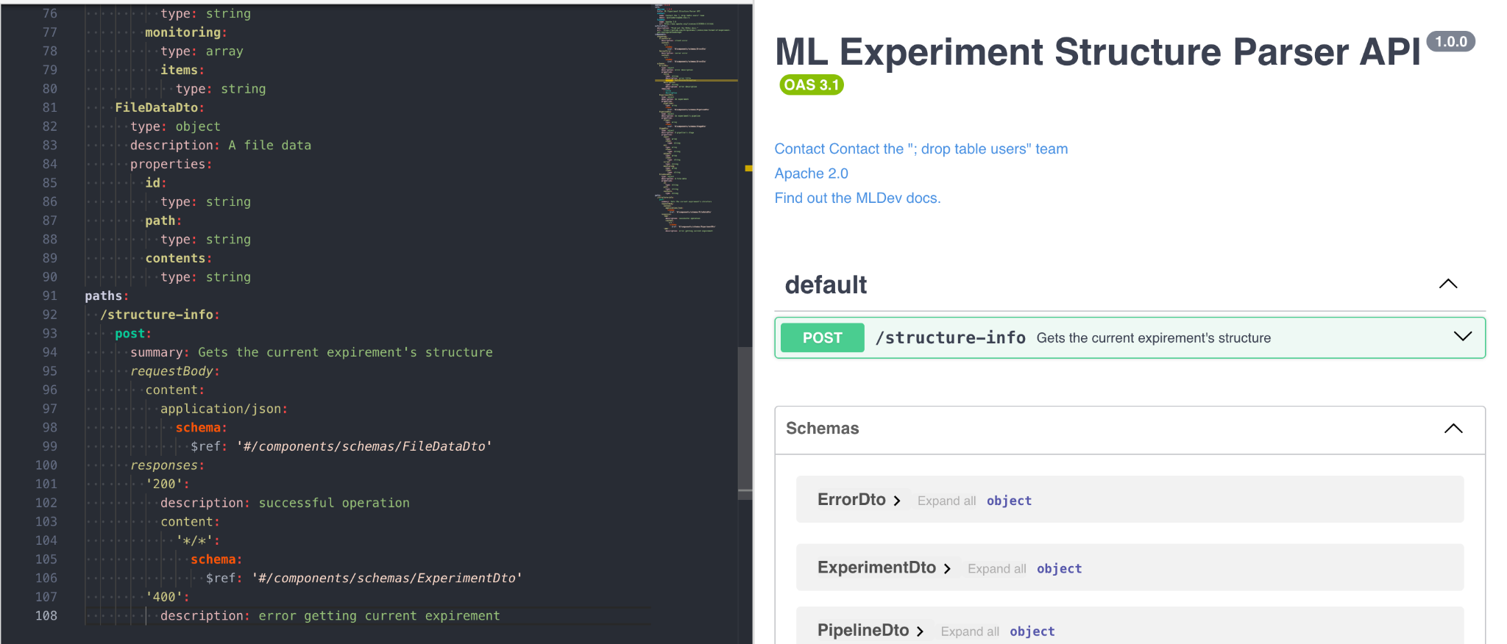
Open API. Experiment Structure Parser

Slide 14
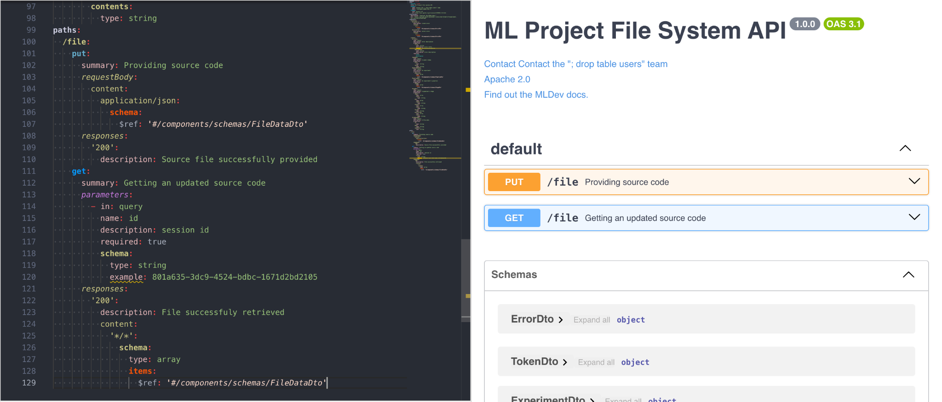
Open API. Project File System

Slide 15
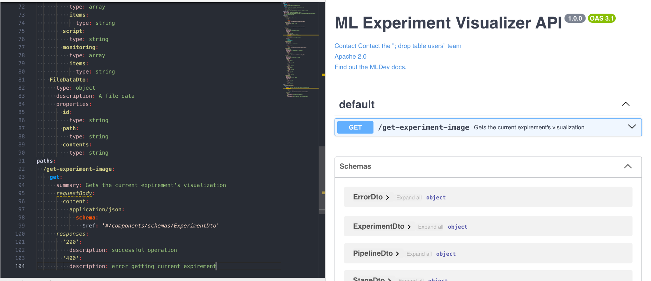
Open API. Experiment Visualizer

Slide 16
Project file system physical schema
The service will be using either:
VS Code API, being a proxy to the local file system
Or a remote file storage API, serving a remote file system
Hence the data stored in a file system (non-relational, graph database).
The files may be indexed using inodes and other OS capabilities.

Slide 17
Other microservices physical schema
Considering the services running in a client environment (browser or vs code), there are no requirements for data persistence besides the contents of an experiment file, written in the editor. In that case file contents will be stored using the “localStorage” in a (non relational) format, where the key will be file’s path. The “localStorage” API’s limitations provided by browsers are sufficient for the task of saving code.

Slide 18
Team work
Sergeev Ilya: Project file system and Web-Editor
Andrew: Experiment Visualizer
Daniil: Syntax Analyzer and Experiment Structure Parser

